Slide 1
DESIGN and ANALYSIS of ALGORITHMS HIMANSHU SRIVASTAVA CSE 2nd Year Roll no. : 181220031

Slide 2


Graph
Algorithms

Slide 3
Introduction to graphs
A data structure that consists of a set of nodes (vertices) and a set of edges that relate the nodes to each other.
The set of edges describes relationships among the vertices .
A graph G is defined as follows: G = (V, E)
V(G): a finite, nonempty set of vertices
E(G): a set of edges (pairs of vertices)

Slide 4
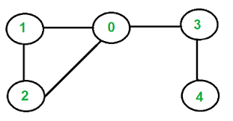
Examples of Graphs
● V = {0, 1, 2, 3, 4}
● E = { (0, 1) , (1, 2) , (0, 3) , (0, 2) , (4, 3) }

Slide 5
Directed vs. Undirected Graphs
Undirected edge : has no orientation (no arrow head)
Directed edge : has an orientation (has an arrow head)
Undirected graph : all edges are undirected
Directed graph : all edges are directed
u
v
u
directed edge
v
undirected edge

Slide 6
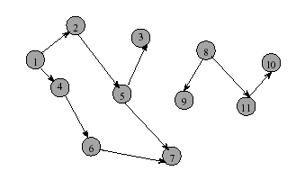
Directed Graph
Directed edge (i, j) is incident to vertex j and
incident from vertex i
Vertex i is adjacent to vertex j, and vertex j is
adjacent from vertex I
6

Slide 7
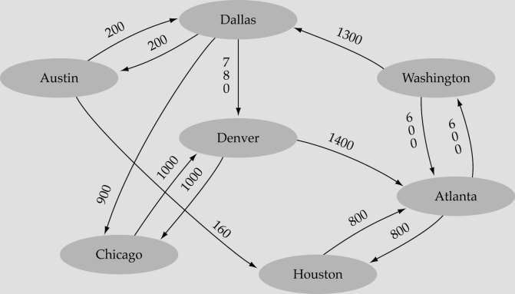
Weighted graph
A graph in which each edge carries a value known as its weight.

Slide 8
Terminologies
Loops : edges that connect a vertex to itself
Paths : sequences of vertices p0, p1, … pm such that each adjacent pair of vertices are connected by an edge
A simple path is a path in which all vertices, except possibly in the first and last, are different.
Multiple Edges : two nodes may be connected by >1
edge
Simple Graphs : have no loops and no multiple edges

Slide 9
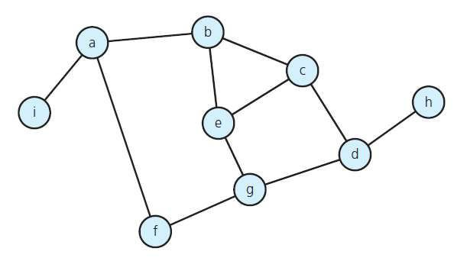
No. of Edges – Undirected Graph
The no. of possible pairs of vertices in an n vertex graph is n*(n-1).
Since edge (u, v) is the same as edge (v, u), the number of edges in an undirected graph is <= n*(n- 1)/2.
Graph
9

Slide 10
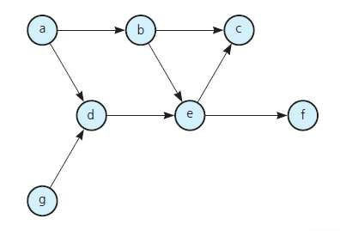
No. of Edges - Directed Graph
The no. of possible pairs in an n vertex graph is
n*(n-1).
Since edge (u, v) is not the same as edge (v, u), the number of edges in a directed graph is n*(n-1)
Thus, the number of edges in a
directed graph is <= n*(n-1).

Slide 11
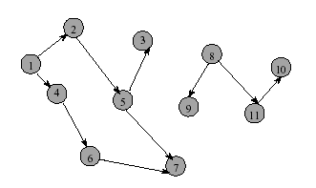
In-degree of vertex i is the number of edges incident to i
(i.e., the number of incoming edges).
e.g., in-degree(2) = 1, in-degree(8) = 0
Out-degree of vertex i is the number of edges incident from i
(i.e., the number of outgoing edges).
e.g., out-degree(2) = 1, out-degree(8) = 2
\

Slide 12
Graph Representation
For graphs to be computationally useful, they have to be conveniently represented in programs.
There are two computer representations of graphs:
Adjacency matrix representation
Adjacency lists representation

Slide 13
Adjacency Matrix
A square grid of boolean (1/0) values.
If the graph contains N vertices, then the grid contains N rows and N columns.
For two vertices numbered i and j, the element at row i and column j is true(1), if there is an edge from i to j, otherwise false(0).

Slide 14
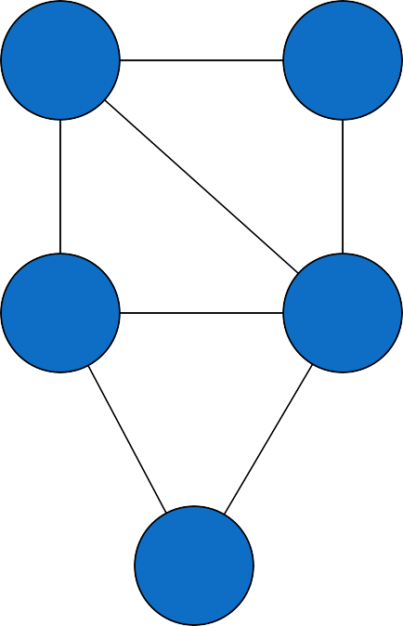
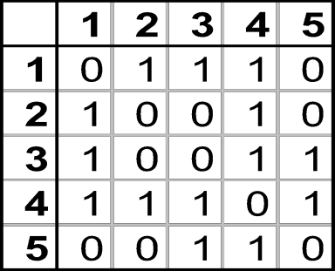
Adjacency Matrix
1
2
3
4
5

Slide 15
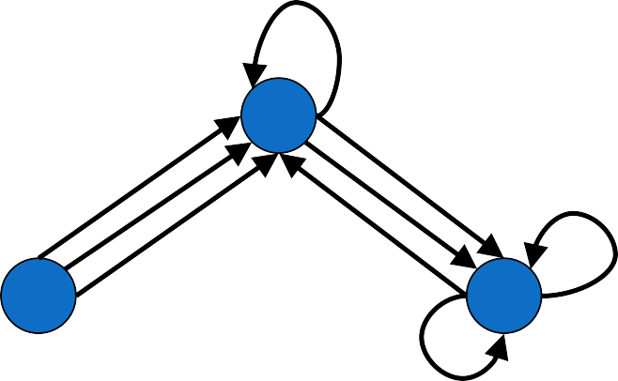
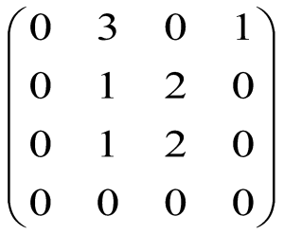
Adjacency Matrix - Directed Multigraphs
2
1
4
3
A =

Slide 16
Adjacency Lists Representation
A graph of n nodes is represented by a one- dimensional array (L) of linked lists, where
L[i] is the linked list containing all the nodes adjacent
from node i.
The nodes in the list L[i] are in no particular order.

Slide 17
Adjacency List
Adjacency list : for each vertex v ∈ V, store a list of vertices adjacent to v.
Example :
adj[1] = { 2 , 3 }
adj[2] = { 3 }
adj[3] = { }
adj[4] = { 3 }
Note : We can also keep
a list of edges coming into vertex
1
2
4
3

Slide 18
Adjacency List
How much storage is required?
The degree of a vertex v = # incident edges
( Directed graphs have in-degree, out-degree )
For directed graphs, # of items in adjacency lists is Σ out-degree(v) = |E|
For undirected graphs, # items in adjacency lists is
Σ degree(v) = 2* |E|
So: Adjacency lists take O(V+E) storage

Slide 19
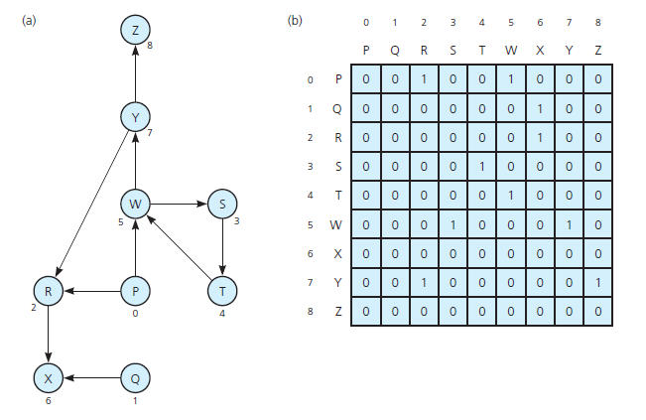
Implementing Adjacency Matrix

Slide 20
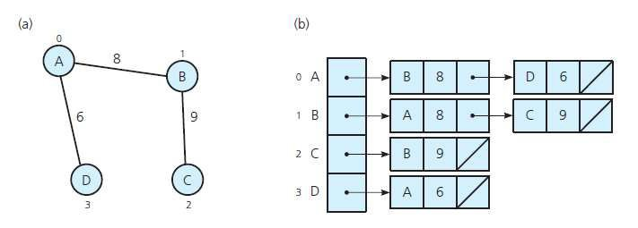
Implementing Adjacency List

Slide 21
Adjacency Matrix vs. Adjacency List
Adjacency Matrix
Good for dense graphs → |E| ~ O( V² )
Memory Requirements : O(|V| + |E| ) = O(|V|² )
Connectivity between two vertices can be tested quickly
Adjacency Linked Lists
Good for sparse graphs -- |E|~O(|V|)
Memory requirements: O(|V| + |E|)=O(|V|)
Vertices adjacent to another vertex can be found quickly

